Slide 1
Java Collections
Sept 19, 2016

Slide 2
Collection framework and Classes
List
Set
Map
Capacity, load Factor
Queue
Stack
Sorting
Comparable/Comparator
Searching
Week Hashmap
Identity Map
Linked Hash Map
Generic
Enum

Slide 3
Objectives
Learn different types of Collections (data structures) provided by JAVA.
Learn when to use which Collection as per the requirement.
Learn the different techniques of Sorting/Searching the Collection.
How the Collection framework established.
How the different data structures works internally.
How to use generics and generic versions of Collection.

Slide 4
Collections
When you need to put many objects into one container.
You need a data structure which is called collection of objects.
Java provide many collections which are suitable to your requirement and reasonably efficient.
Below are the operations that you frequently do on collections-
Add an object to the collection
Remove an object from the collection.
Find out if an object exist into the collection.
Retrieve an object from the collection.
Iterate through the collection

Slide 5

Collection Framework
Collection refers to a container object which groups multiple elements.
Collections are used to store, retrieve and manipulate the aggregated data. For ex. Mail box (Collection of mails), telephone directory (Mapping of name to phone number)
Collection framework is a unified architecture to represent and manipulate collections.
The framework consists of interfaces, implementations and algorithms

Slide 6
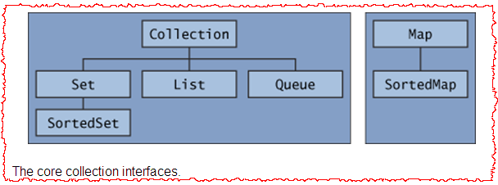
Hierarchy
Two main stream hierarchies - Collection and Map.
Collection is an interface that defines the common contracts like adding, removing and calculating size.
Set and List interfaces extend from Collection interface to provide special capability specific to the given data structure.
Map is the base interface for indexed collection which manipulates key-value pair.
SortedMap and SortedSet are more specialized collections which enable inherent sorting.
Notes:
All the core collection interfaces are generic. For example, this is the declaration of the Collection interface.
public interface Collection<E>...
Collections are tightly integrated with Generics. Generic is a new feature introduced with java 5. Generic helps collection instances to become type safe. Specifying a class during the declaration permits you to add only homogeneous data type. Thereby reduces the chance of ClassCastException at run time.

Slide 7

Benefits
Reduces programming effort.
Increase program speed and quality.
Reduces effort to learn and use new APIs.
Reduces effort to design new APIs.
Notes:
http://download.oracle.com/javase/tutorial/collections/intro/index.html

Slide 8
Features
Store and help manipulate multiple elements including objects and literals.
Provides a lot of utility methods to efficiently search and sort elements.
Sorting and searching is customizable. For ex. sorting order can be customized.
Different collection classes are available for different needs. For ex. ArrayList for retrieval and LinkedList for insertion/removal.
ArrayList
LinkedList
HashMap
TreeSet
HashSet
Vector

Slide 9
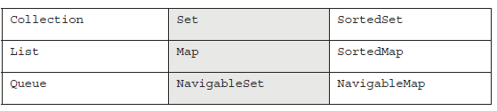
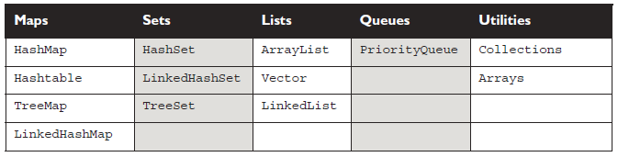
Collection Framework (Interface and classes)
Key interface of Collection Framework-
Core concrete implementation classes

Slide 10
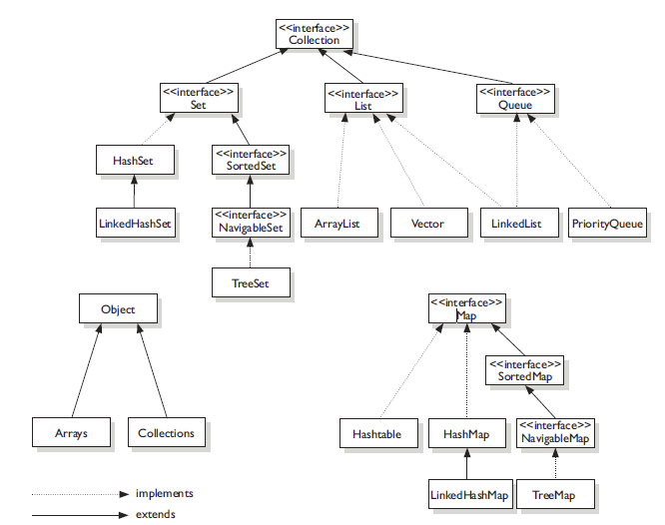
The interface and class hierarchy for collection

Slide 11




Four basic Flavors of collections
List – List of things.It is an interface that represents a linear collection of elements. Order is maintained. Example:- ArrayList, LinkedList.
Set – Unique things. It is also an interface to represent linear collection with no duplicates. Order of insertion is not maintained. Example:- HashSet, TreeSet
Map – Things with unique ID. It represents an indexed collection i.e. key-value pairs. Example:- HashMap
Queue – Arranged by order in which they are to be processed. It is a linear collection but maintains the sequence of elements. Example:- LinkedList

Slide 12
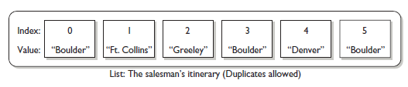
List Interface
Cares about the indexes.
Have set of methods related to index.
Method ex.- get(index), indexOf(element), add(obj, inderx) etc.
All three list implementations are ordered by index position.
Implementations are:
ArrayList
LinkedList
Vector

Slide 13

ArrayList
Resizable-array implementation of the List interface.
Used to store multiple elements but the count is unknown beforehand.
Adding elements at the end and accessing elements at any position is faster.
Costlier in terms of performance if elements are added/removed in between.
List aList = new ArrayList();

Slide 14

Exercise
Write a program that takes the name of five fruits (Fruit is a class) as an input and store them in the ArrayList.
Use the API method to sort the ArrayList based on the natural ordering, i.e. Alphabetically.
Use the API methods to search whether a fruit (input by the user) is present in the arraylist or not.
Demonstrate “FruitBasketTest” example.

Slide 15
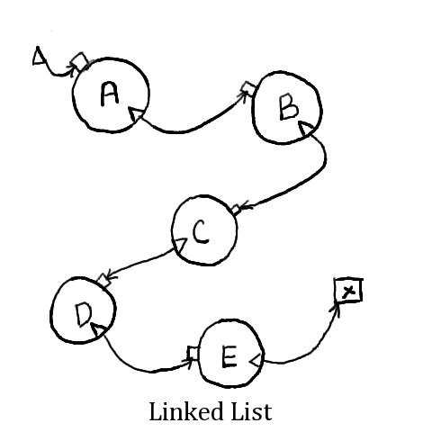
LinkedList
This data structure implies a sequential storage; each element has a way to refer to the next one.
Used when the element needs sequential processing.
Adding and removing elements frequently is faster
Random access to any element using get(index) is costlier in terms of performance.
No initial size is required since it grows element by element.
List<String> aList = new LinkedList<String>();

Slide 16
Vector
Vector is holdover from the earliest days of Java.
Vector is basically same as ArrayList but vector methods are synchronized for thread safety.
Choose ArrayList if you don’t want thread safety.
Like ArrayList, it also implements the RandomAccess interface.

Slide 17

Stack
A stack is a LIFO (Last in First out) data structure. Last added element is removed first.
You use stack when you need to process elements in reverse sequential order.
A stack is empty when created and grows as elements are added to it.
Popular operations are
push – To add an element at the top of the stack.
pop – To remove an element from the top of the stack.
List<String> aStack = new Stack<String>();
Notes:
For ex. Methods are stacked in an execution.

Slide 18

Exercise
Write a program that takes the name of five of your friends as an input and store them sequentially in a LinkedList. Remove the third friend. Use the LinkedList API method to remove and print the name of remaining friends.
Demonstrate LinkedListTest example.
Notes:
Usage of Collections.sort method.

Slide 19
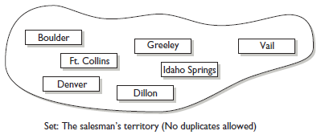
Set (Interface)
A set cares about uniqueness.
Set do not allow duplicate values.
Use equal() methods to determine if the two elements are equal.
Implementations are:
HashSet
TreeSet
LinkedHashSet

Slide 20
HashSet
This class implements the Set interface, backed by a hash bucketing algorithm and Array as a means of storage.
Since hashing is implemented, creating a sufficiently large HashSet enables faster access.
You use it when a large no of elements need to be stored but their order does not matter.
HashSet does not guarantees that the elements will remain ordered over time.
More efficient the hashCode() method implementation, more efficient the hashset will be.
Set<String> aSet = new HashSet<String>();
Notes:
Read more about hashCode and equals method on http://www.ibm.com/developerworks/java/library/j-jtp05273/index.html

Slide 21

HashSet - Ensuring Uniqueness
How set ensures there are no duplicates?
It compares the objects by examining equals() and hashCode() methods.
Given two objects a and b if a.hashCode() == b.hashCode() evaluates to true then it is further evaluated to see if a.equals(b) also results to true.
If both the evaluation results to true then it is assumed that the objects are duplicate.
Notes:
Set ensures uniqueness by evaluating equals() and hashCode() methods. Given 2 objects a and b if a.hashCode() == b.hashCode() evaluates to true then it is further evaluated to see if a.equals(b) also results to true. If both the evaluation results to true then it is assumed that the objects are duplicate.

Slide 22
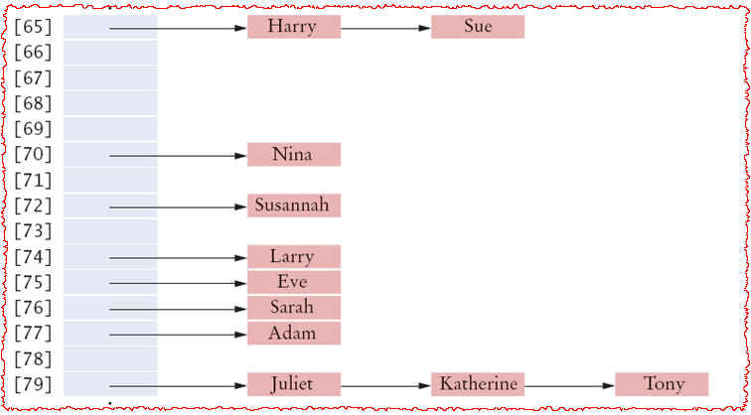
HashSet – Bucketing Algorithm

Slide 23
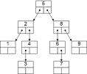
TreeSet
This class implements the Set interface backed by a binary tree.
The elements smaller than the node value are the left child and larger elements are right child.
This class guarantees that the sorted set will be in ascending element order, sorted according to the natural order of the elements.
Elements (Objects) are compared through Comparable or Comparator interface.
Set<String> aSet = new TreeSet<String>();

Slide 24

Exercise – HashSet and TreeSet
Write a program to generate 15 random integers within the range of 0 to 10.
Store the numbers into a collection so that there is no duplicate.
Use the API method to sort them in descending order.
Re-generate the numbers and now store them into a pre-sorted collection.
Notes:
Random r = new Random();
for(int i=0;i<15;i++){
System.out.println(r.nextInt(10));
}

Slide 25
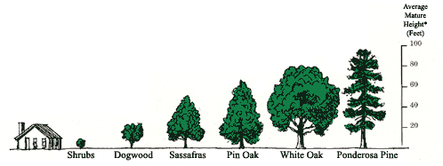
Comparing Elements
There are 2 ways to compare objects in java.
First is to have your custom object implement Comparable interface.
As a part of implementing the interface the custom class should define int compareTo (T other) method. Here this(current) object is compared with the other object.
Based on the comparison result the order of the elements are decided.
The standard classes like String, Integer etc are already implementing Comparable interface.

Slide 26
Comparing Elements(Contd..)
The second way is to -
Sort the collection by calling Collections.sort method and passing the list to sort and an object of a class that implements Comparator (tells how to compare !!) interface.
Collections.sort (List<T> list, Comparator<? super T> c) .
The class that implements Comparator interface has compare (T o1, T o2) method. This method compares two objects and return an integer signifying the result of comparison.
The Comprator is evaluated over the entire collection during sorting.

Slide 27

Exercise
Write a program that sorts the Employees based upon the employee id and name.
The comparison using employee id is implemented through Comparable interface and use Comparator to sort through by employee name.
Demonstrate EmployeeCompareTest example.

Slide 28

Exercise – Sorting Bicycles (Optional Exercise)
The Bicycle class (implemented in the last example) takes price in the constructor and sets it in the instance variable. Write a program to sort the Bicycle classes in the ascending order of price.
Demonstrate “BicycleSortingTest” example.
Understand the following
Implementation of multiple interfaces
Comparable interface.

Slide 29
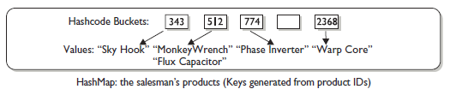
Map Interface
Map cares about unique identifiers.
Map a unique id to a specific value.
Map allows you to search things based on the key, you can ask for a collection of just of the values.
Maps rely on equals() method to determine whether two keys are same or different.

Slide 30
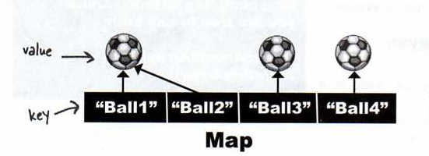
HashMap
HashMap is a hashing based implementation of Map interface to store key-value pairs.
Values can be duplicated but not the keys.
It is used to store key-value pairs where key and value both can be custom java class.
Creating with sufficiently large capacity helps make the storage efficient and improves performance.
HashMap does not keep elements in ordered manner.
Source: Head First Java
Map<String, Integer> aSet = new HashMap <String, Integer>(75);

Slide 31
Capacity and Load Factor
An instance of HashMap has two parameters that affects its performance
Initial Capacity
Load Factor
Initial Capacity is simply the capacity at the time the hash table is created.
The load factor is measure of how full the hashtable is allowed to get before its capacity is automatically increased.
Default capacity is 16 and load factor is .75
That means by default when you put the 13th element in a hash map, it will resized and double the capacity.
While resizing it copies the elements from previous hashtable to new hash table with all the index updated. So resizing is a heavy operation.

Slide 32
Exercise
Create a HashMap with key (Integer) and value (String). Store the employee id and name as key-value pair in the HashMap.
Use the API methods to print the keys of the Map. Delete the employee id #4 from the Map and print the remaining key-value pairs.
Demonstrate “MapTest” example.
Emp Id | Emp Name
001 | Steve
002 | Rob
003 | Peter
004 | Mark
005 | John
006 | Tom

Slide 33
Internals of a HashMap
The JAVA HashMap class implements the interface Map<K,V>. The main methods of this interface are:
V put(K key, V value)
V get(Object key)
V remove(Object key)
Boolean containsKey(Object key)
HashMaps use an inner class to store data: the Entry<K, V>.
A HashMap stores data into multiple singly linked lists of entries (also called buckets or bins). All the lists are registered in an array of Entry (Entry<K,V> array) and the default capacity of this inner array is 16.
All the keys with the same hash value are put in the same linked list (bucket). Keys with different hash values can end-up in the same bucket.

Slide 34
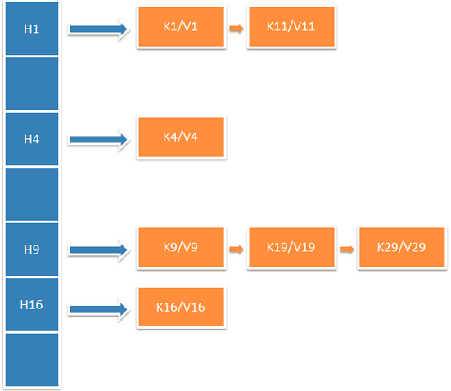
Internals of HashMap (Contd..)

Slide 35
Internals of HashMap (Contd..)
When a user calls put(K key, V value) or get(Object key), the function computes the index of the bucket in which the Entry should be. Then, the function iterates through the list to look for the Entry that has the same key (using the equals() function of the key).
In the case of the get(), the function returns the value associated with the entry (if the entry exists).
In the case of the put(K key, V value), if the entry exists the function replaces it with the new value otherwise it creates a new entry (from the key and value in arguments) at the head of the singly linked list.
This index of the bucket (linked list) is generated in 3 steps by the map:
It first gets the hashcode of the key.
IIt takes the hashcode and bit-masks it with the length (minus 1) of the array. This operation assures that the index can’t be greater than the size of the array. You can see it as a very computationally optimized modulo function.

Slide 36

Quiz Time
How can I access an element in a List?
What are the ways to traverse a collection?
What is the interface the Objects must implement in order to become sortable?
When will you use Comparator?
What are the methods involved to justify uniqueness in a Set implementation?
I want to order my elements in such a way that whoever added last gets removed first. Which collection should I use?
What are the methods to be overridden to use a custom class as key of a Map implementation?
Notes:
Mylist.get(index)
For loop on size of collection and then retrieving the element based upon index. Iterators are other ways to traverse the collection.
Comparable
When a collection needs to be sorted by more than one way.
hashCode and equals
Stack
hashCode and equals

Slide 37
Hashtable
Like Vector, Hashtable are holdover from earliest days of java.
Hashtable is synchronized counterpart of HashMap.
The key methods of Hashtable are synchronized.
HashMap allows you a null value as well as a null key but Hashtable do not allow you anything that’s null
From Java 5, if you need synchronized functionality- use ConcurrentHashMap and not Hashtable.
Hashtables are not much used now because of performance hit.

Slide 38
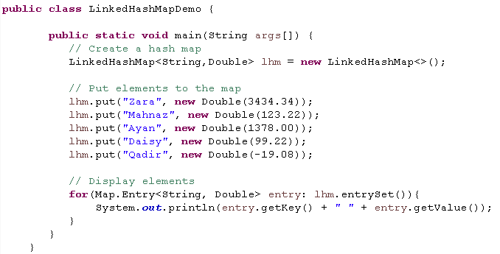
LinkedHashMap
Extends HashMap and maintains a linked list of entries in the map.
Maintain insertion order
Adding and remove operations are slower than HashMap
Iteration is faster than HashMap
You can create a LinkedHashMap that returns its elements in the order in which they were last accessed.

Slide 39
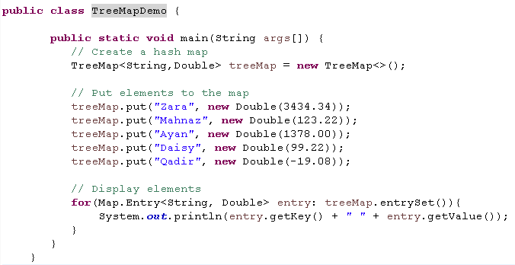

TreeMap
A TreeMap provides an efficient means of storing key/value pairs in sorted order.
Allows rapid retrieval
It makes sure that its elements are sorted in an ascending order.
It uses Comparator/Comparable to sort the elements
Output

Slide 40
WeakHashMap
An implementation of map that stores only weak references to its keys.
Storing only weak references allows a key-value pair to be garbage-collected when its key is no longer referenced outside of the WeakHashMap.
Useful for implementing registry-like data structures where the utility of an entry vanishes when its key is no longer reachable by any thread.
Weak Reference-
f the only references to an object are weak references, the garbage collector can reclaim the object's memory at any time.
t doesn't have to wait until the system runs out of memory.
WeakHashmap can be used to make a customized String pool.

Slide 41
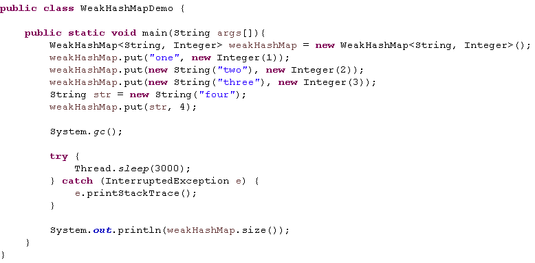
WeakHashMap (Contd..)
Look at WeakHashMapDemo code
We are creating a new WeakHashMap and we put 4 entries.
First is String literal, other 2 are new String objects and fourth is with a reference present in our program.
Run the code and output shows the map size to be 2.
We added 4 elements. :
Out of which 2 has strong reference available. Key “four” has a live reference as str. And key “one” is string literal and reference in string pool.
Hence the size is 2 after System.gc()

Slide 42
IdentityHashMap
Use reference-equality in place of object-equality when comparing keys (and values).
In IdentityHashMap, Keys k1 and k2 are considered equal if and only if k1 == k2.
This class is not a general-purpose Map implementation
It intentionally violates Map's general contract, which mandates the use of the equals method when comparing objects
A typical use of this class is topology-preserving object graph transformations, such as serialization or deep-copying.
Faster than HashMap and TreeMap.
IdentityHashMap does not require keys to be immutable as it does not relies on equals() and hashCode() method.

Slide 43
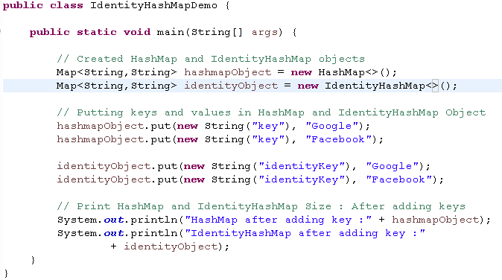
IdentityHashMap(Contd..)
Example
Output

Slide 44

Queue Interface
Holds a list of “to-dos” or things to be processed in some way.
Typically used as FIFO (First in First Out)
Support methods like poll, top etc.
Implementations
PriorityQueue
Queue operations

Slide 45
PriorityQueue
Creates priority-in and priority-out queue as opposed to FIFO queue.
PriorityQueue elements are ordered either by natural ordering or according to a comparator.
The elements ordering represents their respective priorities.
A priority queue does not permit null elements.
Heavily used when we have some task which should be executed in some specific priority order.

Slide 46
Exercise
We have our custom class Customer that doesn’t provide any type of ordering, so when we will try to use it with PriorityQueue we should provide a comparator object for that.
Create a class Customer with id (int) and name(String) as parameter of the class.
Create a PriorityQueueApp class. Instantiate a new priorityQueue in its main method.
Put the elements in random order into the priority queue. Use RandomGenerator to create the ids of custormer.
Make a comparator to sort the customer objects in increasing order of id.
Process the elements our of priority queue.

Slide 47
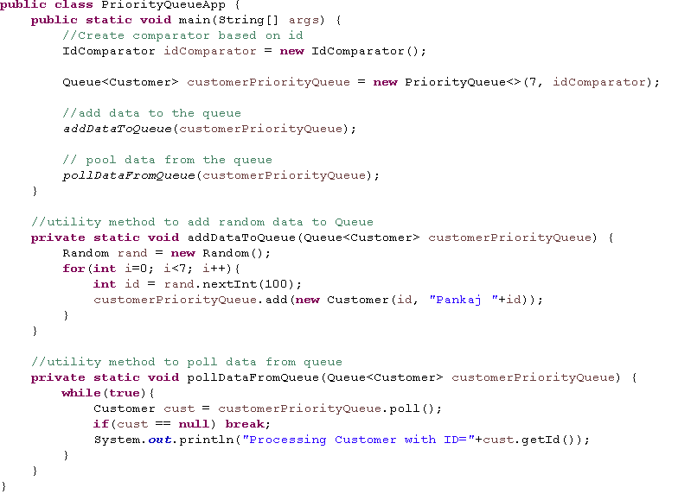
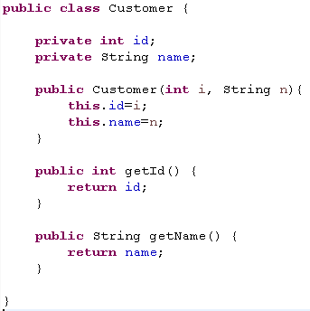
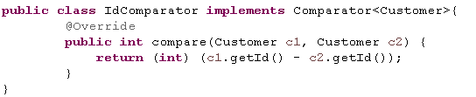
Solution

Slide 48

Sorting
Both Collections and Arrays can be sorted.
Java API provides methods to sort the elements in a collection/Array.
Arrays.sort() method is used to sort arrays
Collections.sort( List) is used to sort lists.

Slide 49
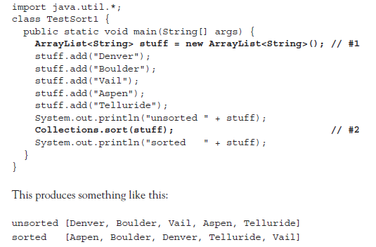
Sorting Collections
Let’s start with sorting strings in a collection
ArrayList containing strings is sorted with Collection.sort() method.

Slide 50

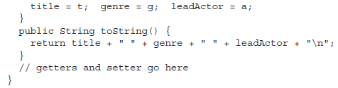


Let’s sort DVDInfo
Lets have another example of DVDInfo class sorting
Here is a small piece of code from an application
Now if I try to sort the ArrayList and I say-
Collections.sort(dvdList)
It throws an exception

Slide 51
DVDInfo (Contd..)
What are we missing ?
We know Collections class has a sort() method.
Remember Collections.sort() method takes a collections of object which are comparable. See below the complete signature of method-
public static <T extends Comparable<? super T>> void sort(List<T> list)

Slide 52
Comparable
Comparable both interfaces provide functionality to sort objects in a collection.
Collections.sort() and Arrays.sort() methods uses instance of Comparable.
To implement comparable interface, a class must implement a single method- compareTo()
Invocation
Int x = thisObject.compareTo(anotherObject)
The compareTo() methods returns an int with following characterstics-
Negative – if thisObject < anotherObject
Zero - if thisObject = anotherObject
Positive - if thisObject > anotherObject

Slide 53

compareTo() method
The sort() method from collections use compareTo() method to determine how the list or object array should be sorted.
Modify the DVDInfo as below and again run your program-
DVDInfo class is sorted on the bases of title here.
Now what if we want to sort it on the basis of genre too ? Or on basis of some other parameter of DVDInfo?
Comparator to the rescue!

Slide 54
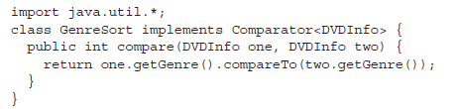
Comparator
Comparator too is used for sorting.
Collections.sort() method has another overloaded form which takes comparator as argument.
public static <T> void sort(List<T> list, Comparator<? super T> c)
Comparator interface gives you capability to sort a given collection any number of different ways and you don’t have to change the class for that.
For using Comparable you had to modify the class. ( as we modified DVDInfo class)
For using Comparator you don’t need to change the class.
Here is small calss that can be used to sort a List of DVDInfo instance, by genre
The comparator.compare() method returns an int whose meaning is same as the Comparable interface.

Slide 55
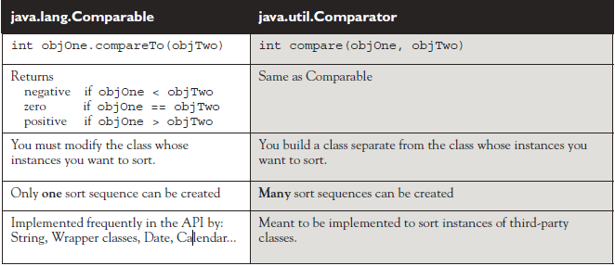
Comparing Comparable to Comparator
Both Comparable and Comparator are so similar, but there are differences-

Slide 56
Sorting with Arrays Class
Java.util.Arrays class is used to sort arrays.
Arrays.sort() method has two overridden form just like Collections.sort()
Arrays.sort(arrayToSort)
Arrays.sort(arrayToSort, Comparator)
Arrays.sort() on primitives always sort on the basis of natural order.
Sort() methods for both Arrays and Collections classes are static methods.

Slide 57
Exercise
Create and Employee class.
Create an array of Employees and sort it on the basis of employee ID.
Use Comparator to sort employees on the basis of their age.
Create an arryayList.
Add Employee objects to the ArrayList and sort them.
Print the elements out of that list using iterators.

Slide 58
Searching
Arrays and Collections provides methods to search specific elements.
Following rules apply, whenever we search using Arrays or Collections
Searches are performed using the binarySearch() method.
Successful search return an int index of the element being searched.
Unsuccessful search return an int index that represents the insertion point.
The collection/array being searched must be sorted before you can search it.
If you attempt to search an array that has not been sorted, result would be unpredictable.
If the collection/array you want to search was sorted using a Comparator, it must be searched using the same comparator. Pass the comparator as the second argument to binarySearch().

Slide 59
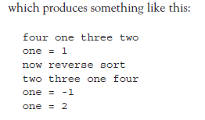
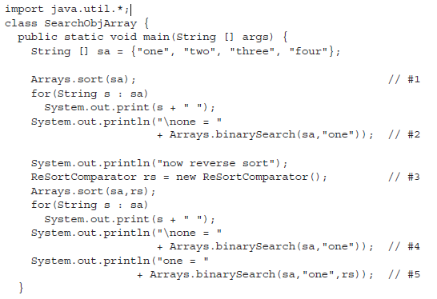
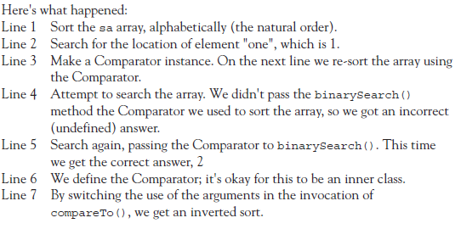
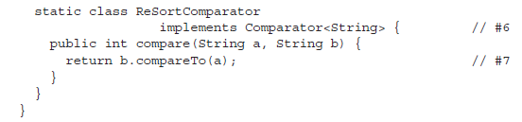
Searching (contd..)
Example

Slide 60
Exercise
From Employees List, Search an Employee Object.
Provide an comparator based on Id for search.
Remember to use binarySearch, collection must be sorted.

Slide 61
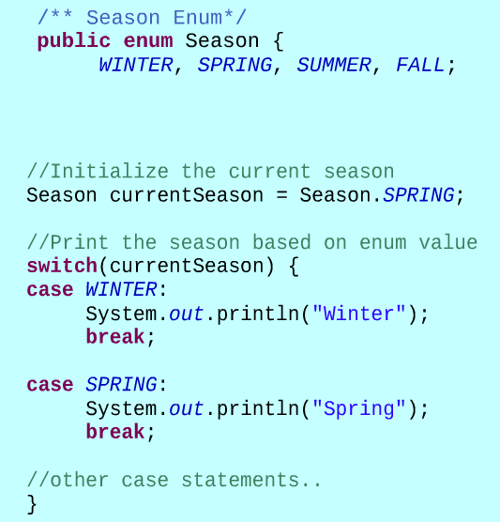
Enum
Enum is a type like Class or Interface
The enum keyword allows you to create a new type with a restricted set of named values.
Enum type was introduced in JDK5.
Following 3 components are required to create a basic enum type:
Enum keyword
Name of the enum
List of allowed values
Convention: Capital Letters for all enumerated type identifiers.
Enum types can be used in the switch statement

Slide 62
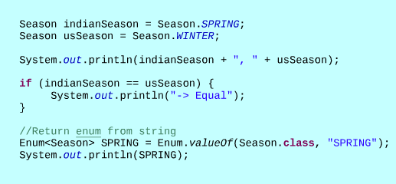
Enum Features
When you create an enum, an associated class is produced by compiler.
This class is automatically inherited from java.lang.Enum.
Enum values are public, static and final.
Enums can be compared with ==.
Enums override toString() method to return a String version of enum.
Enums provide valueOf() method to return enum from String.

Slide 63
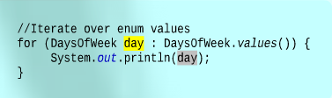
Iteration over Enum values
Static method “values()” produces an array of the enum constants in the order in which they are declared.
The resulting array can be used in a for loop to iterate over all the values of the enum.

Slide 64

Exercise
Create an enum for four directions North, South, East and West.
Create and Array List of above four elements and print the elements in the Array List.
Take two direction inputs from the user in the form of String. Convert them to enum and check if these are equal.
Implement it as DirectoinTest.java

Slide 65

Exercise
Create an enum for type of citizens in India
CHILD
ADULT
SENIOR_CITIZEN
Take and input from the user about the type of citizen in the form of String. Convert it to Enum and print the following using switch statements:
CHILD: The age range is between 0 to 18
ADULT: The age range is between 18 to 60.
SENIOR_CITIZEN: The age range is above 65.
Implement it as CitiizenTest.java

Slide 66
Adding methods to an Enum
You can add methods to an enum.
The constructor and methods have the same form as a regular class.
The constructor can only be used to create the enum instances that are declared isnide the enum definition.
If methods are defined in enum, they must be defined under the enum instances.
Enums can also have a main method.

Slide 67
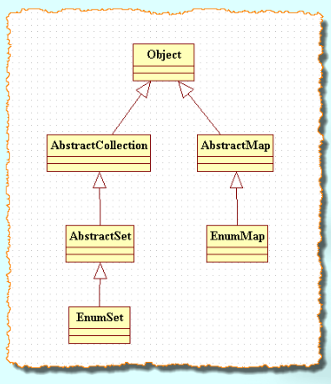
Enums and Collections
There are two important collections that uses enum
EnumSet
EnumMap
EnumSet contains a collection of distinct enums.
EnumMap Contains a map having the keys as enum type.

Slide 68
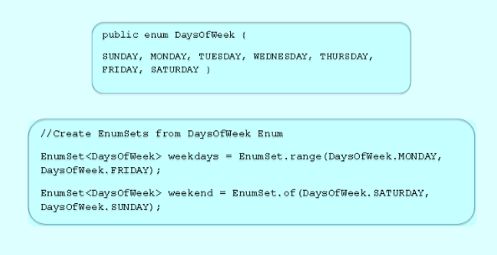
EnumSet
A specialized set implementation to be used with enums.
The elements of an EnumSet must come from a single enum.
Null elements are note permitted in EnumSet.
EnumSet is designed for speed. Values in an EnumSet are represented internally as bit vectors.
This representation is extremely compact and efficient and is faster than a hashset.

Slide 69
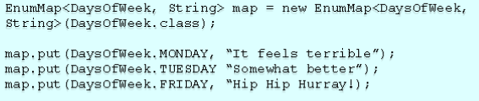
EnumMap
A specialized map implementation that uses enum as key.
All the keys of a EnumMap comes from a single enum.
EnumMap is ordered in the natural order of their keys.
EnumMap is extremely fast as it is internally represented as an array.

Slide 70
Exercise
Create an enum for the new planetary system. Enum stores the mass and volume of the planet.
Provide method to calculate density on the planet. Density is defined as mass/volume
Iterate over all the elements of the planet and print their name along with density.
Implement it as NewSolarSystemTest.java
Exercise
Create an EnumSet of existing planets using the enum created in previous exercise.
Display the name and density of each planet.
Implement it as ExistingSolarSystemTest.java

Slide 71

Exercise
Create an enum type for the four suites of playing cards: HEART, SPADE, CLUB and DIAMOND
Implement it as SuitTest.java
Create an enum type for the rank of the playing cards they are DEUCE, THREE, FOUR, FIVE, SIX, SEVEN, EIGHT, NINE, TEN, JACK, QUEEN, KING and ACE. Assign the 3 points for Jack, 2 points for Nine , one point for each Ace and Ten as per the rule of the Game 28
Implement it as RankTest.java

Slide 72

Assignment
Create an Enumeration of the following grades in a school
A – Topper
B – Average
C – Poor
F – Fail
Create a Student class with the following attributes
Roll Number: Integer
Student Name: String
Grade: <Enum_Type>
Instantiate two Student objects, set the above instance variable and print their values.

Slide 73
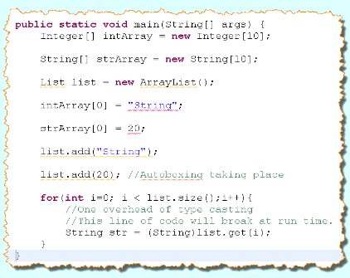
Need of Generics
Array are type safe. A string can not be inserted into an Integer array.
Collections are not type safe.
Collections take Object as input so a List can contain a String Object and an Integer Object simultaneously.
Getting an item from the collections requires unnecessary type casting.
Code breaks at run time.

Slide 74
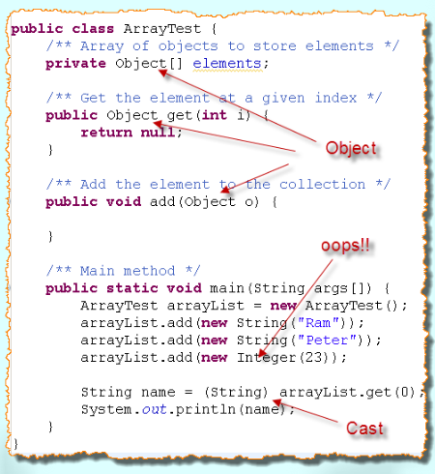
Introduction
Generics was introduced in Java 5.
Allows a Class or a method to operate on objects of various types while providing compile-time type safety.
Allows to write safer and easier to read code than the code littered with Object variables and casting.
Particularly useful with collection classes.

Slide 75
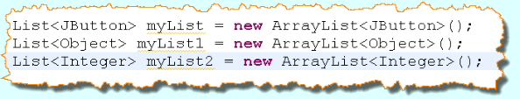
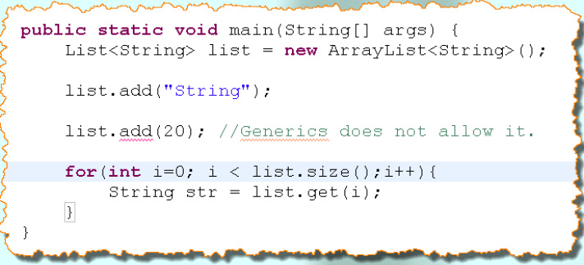
Generics: Usage in Collection
The java type is placed inside < > after reference type and constructor as shown below.
Use of Generics

Slide 76
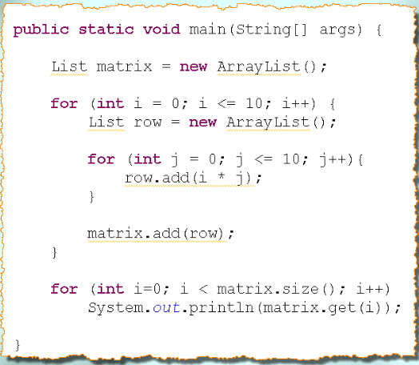
Exercise
Change the below code to use Generics

Slide 77

Exercise
Create a HashMap with following key-value pair
Key (Integer) – Trainee Batch ID
Value (List of Strings) – Name of the trainees (add 3-4 names)
Add the trainee details of at least two batches and then print the key-value pairs through SOP.
Implement it using TraineeBatchTest.java

Slide 78
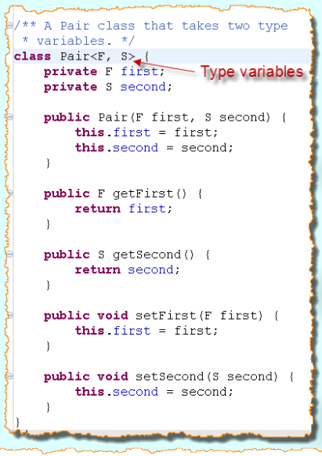
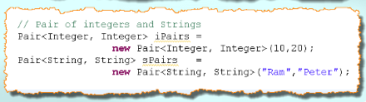
Generic Types
Is A Class or Interface with one or more type variables.
Type variables are used throughout the class to declare types of fields and method return type.
Class is instantiated by substituting type for the type variable.

Slide 79
Raw Types
A raw type is the name of a generic class or interface without any type arguments.
To create a parameterized type of Box<T>, you supply an actual type argument for the formal type parameter T:
Box<Integer> intBox = new Box<>();
If the actual type argument is omitted, you create a raw type of Box<T>:
Box rawBox = new Box();

Slide 80
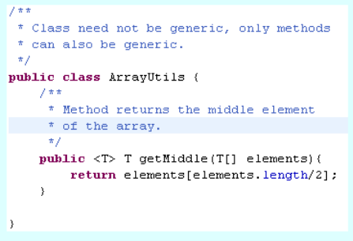

Generic Method
Generic methods are methods that introduce their own parameters.
Can be defined in an Ordinary class.
Declared without any specific type as argument.
Type variable is declared before the return type of the method.
Static and non-static generic methods are allowed, as well as generic class constructors.

Slide 81

Exercise
Create a generic class accepting two type variables one for minimum and second for maximum value.
Write a test class that initializes an array of Integer in main method and then passes it to a private method to determine min and max value.
The private method then instantiate the object of generic class, stores min and max values and return it to calling method.
Implement it as MinMaxTest class.

Slide 82

Exercise
Create a generic method that accepts an array as parameter and returns the middle element of the array.
You can take the assumption that the length of array passed as parameter will always be odd.
Pass an array of Integers and an array of String.
Implement it as MiddleElementTest.java

Slide 83
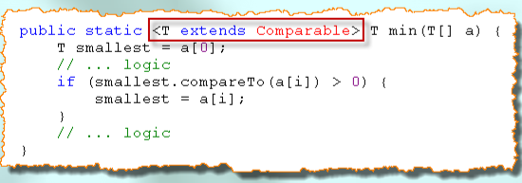
Bounds of Type Variable
Used to place restrictions on type variables.
What if we would like to ensure that the type variable has compareTo method implemented.
Or, we only want to work on all the classes which implement a certain interface.
Extends keyword is used
Can have multiple bounds separated by &
<T extends B1 & B2 & B3>
Bound types can have at most once class and/or one or more interfaces.
Class should be first in the bound list

Slide 84
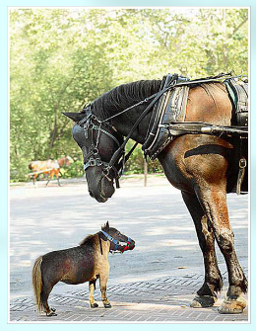
Exercise
Modify the MinMaxTest program to write a generic method that can accept any type array and return an instance of MinMax class.
Use the Comparable bound with the type variable.
Implement it as MinMaxBoundTest.java

Slide 85
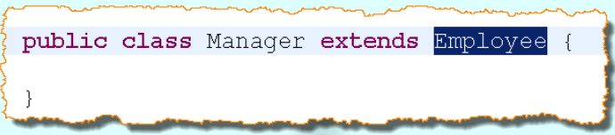
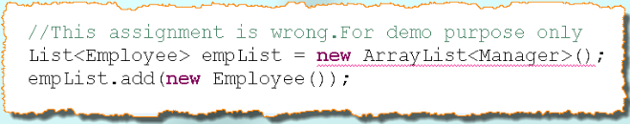
Inheritance rules of generic types
In general, there is no relationship between Pair<S> and Pair<T> no matter how S and T are related.

Slide 86
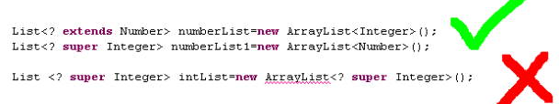
Wild Card
Wild cards are helpful in this regard.
“?” is a wild card used to establish relationship between super class and subclass.
Following are legal:

Slide 87

Exercise
Create a generic method that can accept Pair<Employee> or Pair<Manager> and print the buddies on output console. Manager class extends Employee class.
Use the wild card type in method parameter.
Implement it as PrintBuddiesTest.java

Slide 88

Type Eraser
Generic type information is erased at run time.
Technique used by compiler for compilation of the generic code.
A process by which a compiler removes all information related to type parameters and type arguments.
Maintains the compatibility of legacy code with generic code.
At run time, the exact type of a generic class can not be found.

Slide 89
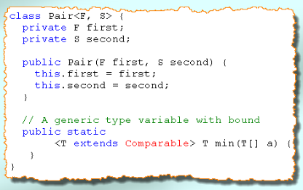

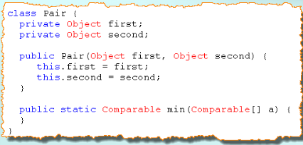
Type Eraser (Contd..)

Slide 90
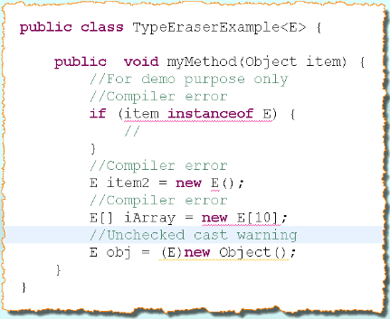
Limitations
Runtime type inquiry works only with raw types.
Type variables can’t be instantiated.
Arrays of parameterized types are not legal.
You can’t throw or catch instances of a generic class.

Slide 91
Recap
Collections
Map – Unique Identifiers
HashMap
hashCode()
Equals()
TreeMap
Sorted map (based on key)
Hashtable
Synchronized counterpart of HashMap
List – list of things that maintains indexes
ArrayList – Grow able list
LinkedList – maintains Insertion order
Vector – synchronized counterpart of array list

Slide 92
Recap
Set – Unique elements
HashSet
Use hashcode() to store unique elements.
Use values as key of hashmap internally
TreeSet
Sorted set
Sorted based on natural order or comparable/comparator
Queue- list of things to do, in FIFO order basically
Priority Queue
Provide access to object in certain priority order.
Priority is decided on the basis of natural order or comparator/comparable.

Slide 93
Recap
Sorting
Collections.sort() – two overloaded form that takes as argument-
List of comparable objects
List of objects and comparator
Arrays.sort() – two overloaded form that takes as argument-
List of comparable objects
List of objects and comparator
Searching
Collection/Array must be sorted
Can be done in two ways-
Collections.binarySearch()
Two overloaded form like sort method
Arrays.binarySearch()
Two overloaded form like sort method

Slide 94
Recap
Enum
Restricts the values of specific type
Can be used in switch-case
Enums can have constructors
Enums can have methods
Enums can implement/extend an interface/class
Enums provides methods through which you can get a set of all the values of the enum
Generics
Provide type safety for collections
<> are used to specify the generic type.
Type safety is not available at run-time. Type eraser erase generic types before execution. This is done to support backward compatibility.
You can have your own generic classes and methods
Wild cards are used in case of hierarchical generic types like <? Extends Animal> but it make it readable.

Slide 95
References
http://www.javatpoint.com/collections-in-java
SCJP (Kathy Seira)

Slide 96
THANK YOU

